Slide 1
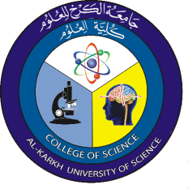

Materials Science and Nanotechnology
Asst. Prof. Ali J. Mohammed
Lecture Six
Introduction to NanoScience
Medical Physics Dept. , 2nd stage, 1st semester, 2018-2019

Slide 2

Introduction to Nanoscience & Nanotechnology
What is Nanoscience? Or Nanotechnology?
Nanoscience is the scientific study at the atomic and molecular scale of molecular structures with at least one dimension measuring between 1 and 100 nanometers in order to understand their physico-chemical properties.
Nanoscience means research on any structure of matter that comprises of at least one nanometric dimension
nanotechnology involves all of the following: - Research and technology development at the atomic, molecular, or macromolecular levels, in the length scale of approximately 1 to 100 nanometer range.
Richard P. Feynman, 1959.!
“ There’s plenty of room at the bottom ! ”
Medical Physics Dept. , 2nd stage, 1st semester, 2018-2019

Slide 3
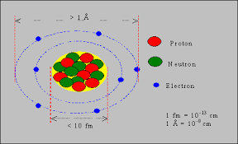
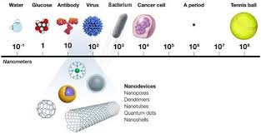
Nanoscales
Nuclear scale: 10⁻¹⁵ m or 10⁻⁶ nm.
Atomic scale: 0.1 nm or 1 angstrom (Å).
De Broglie wavelength in metals: ~1 nm.
DNA molecules: 2 – 12 nm.
Mean free path in polycrystalline metal : 10 nm.
Viruses: 10 – 100 nm.
Nanostructures: less than 100 nm
Medical Physics Dept. , 2nd stage, 1st semester, 2018-2019

Slide 4
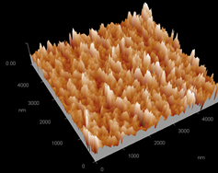
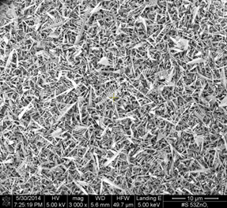
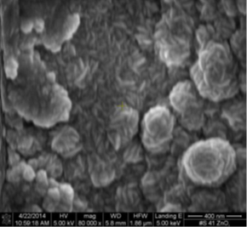

Slide 5
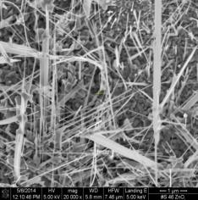
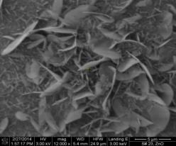
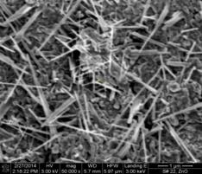
Our
Samples
IMP, 2014
Supab Choopun et.al.,
INTECH , 2012
M.R.Khanlary et.al.,
Molecules, 17, 2012
Medical Physics Dept. , 2nd stage, 1st semester, 2018-2019

Slide 6
The scale of things
A soccer ball with a diameter
∼ 30 cm = 3 x 10⁻¹ m.
The width of a human hair (here placed on a microchip at the white arrow) is roughly 10⁴ times, i.e.
∼ 30 μm = 3 x 10⁻⁵ m.
The diameter of a carbon nanotube (here
placed on top of some metal electrodes) is yet another 10⁴ times smaller, i.e.
∼ 3 nm=3 x 10⁻⁹ m.
Medical Physics Dept. , 2nd stage, 1st semester, 2018-2019

Slide 7
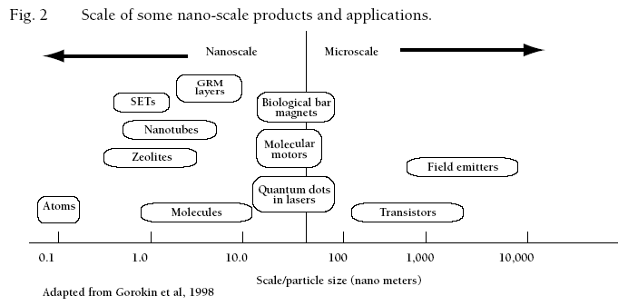
Nanoscales
Medical Physics Dept. , 2nd stage, 1st semester, 2018-2019

Slide 8

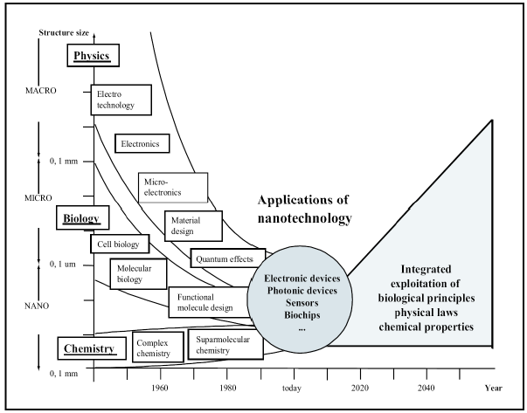
Physics, biology and chemistry
Medical Physics Dept. , 2nd stage, 1st semester, 2018-2019

Slide 9
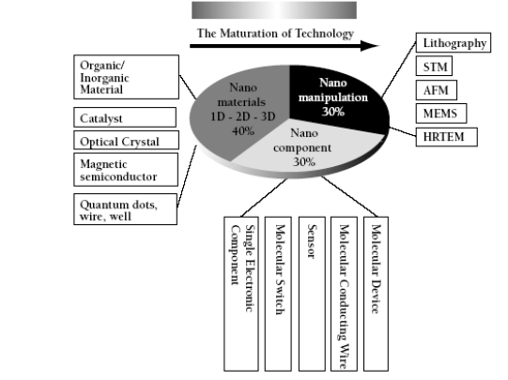
Nanotechnologies
Medical Physics Dept. , 2nd stage, 1st semester, 2018-2019

Slide 10

Nanoscience is a combination of bottom up chemistry and top down engineering technique.
Quantum dots (QD) are tiny devices that contain free electrons.
QDs are semiconductor structures in which electron wave function is confined to all three dimensions.
The bound pair of electron and hole is called “exciton”.
Bohr radius of exciton
Medical Physics Dept. , 2nd stage, 1st semester, 2018-2019

Slide 11
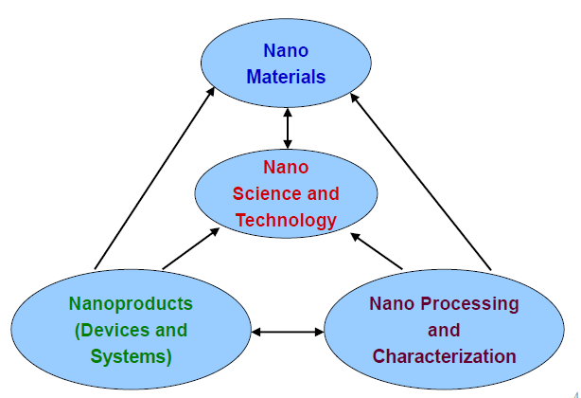
Major Topics of Nanoscience and Technology
Medical Physics Dept. , 2nd stage, 1st semester, 2018-2019

Slide 12
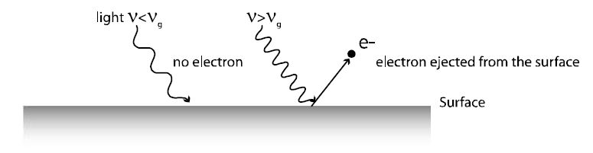
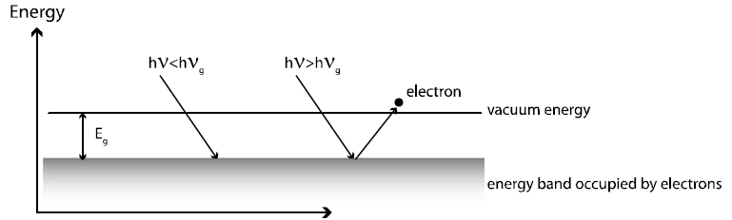
The ability of growing the nano scale materials and structures
The ability of detecting and manipulating on the nano scale.
Advance in thin film fabrication: Such as Molecular Beam Epitaxy(MBE), atomic layer deposition (ALD), laser (MBE), etc…
➢ For Nano electronics in metals, oxides, and semiconductors
PHOTOELECTRIC EFFECT
Medical Physics Dept. , 2nd stage, 1st semester, 2018-2019

Slide 13
Nano Materials
we can produce structures with one, two or three nanometric dimensions
Nano particles
* top down (dispersion).
* bottom up (nucleation and growth)
- Dispersion means taking bulk material and fragmenting it.
- Growth describes the first-order phase tradition from an atomically dispersed phase to a solid condensed phase.
Medical Physics Dept. , 2nd stage, 1st semester, 2018-2019

